Slide 1


Progress Report: 9
Team Charlie
Aakansha Bhatt, Anshu Paudyal, Ingmar Diaz, Michael Foster, Raunaq Chopra, Yang Ye
March 4th 2021

Slide 2
Teamwork via zoom
Have to do:
Update the milestone for the Beta prototype

Slide 3
Aakansha Bhatt
Last week 8 | This week 9
Hardware: N/A | Hardware: N/A
Mechanical: N/A | Mechanical: N/A
Firmware: I researched about the sensors required for the project and we finalized what would be needed. They need to be ordered. Furthermore, I talked with team NASA and they ordered extra shaft encoders and would be willing to give us one so I have been researching about how to write the code for it. | Firmware: Anshu and I worked on trying to get the H-bridge and the PSOC connected so as to change the direction of the rover movement and to increase and vary the speed of the same. We also talked about how to implement the shaft encoder to measure speed. As of right now, I tried to implement the different speeds for the rover. We still have to try to implement the directional movements. Team NASA also gave us their extra shaft encoders.
Software: N/A | Software: N/A

Slide 4
Anshu Paudyal
Week 9 | Weekend & Week 10
Worked with Aakansha and Raun to test out the Firmware for the H-bridge. Generate PWM signal using pSoc→ drive the h-bridge Problem: we are trying to generate PWM signal as per the interrupt send by button. (the firmware is yet to be tested) | Test out the most recent program for the H-bridge and implement that with rest of the rover system. Work on the documentation and making video.

Slide 5
Ingmar Diaz
Last week 8 | This week 9
Hardware: | Hardware:
Mechanical: Met with Nick in OH for 3D enclosures suggestions | Mechanical:
Firmware: Implemented a simplified power analysis circuit and tested ADC component of PSOC in Design. Also going to Nick’s OH to see what I can do. | Firmware: Implemented voltage divider into power analysis circuit and was able to scale up the values. However, having trouble correctly displaying into OLED need to research more on Graphics Library and variable types and functions in C.
Software: | Software:

Slide 6
Michael Foster
Last Week: 8 | This Week: 9
Hardware: N/a | Hardware: N/a
Mechanical:N/a | Mechanical:N/a
After resting this weekend and this week, I feel like I am fully recovered and began continuing my part on my part. Still trying to figure out how to implement the battery via | Met with group to figure out what are the next steps to this project. Was only able to spend a day researching and working. I’ve had to put more energy into my other classes this week since I have two design
Psoc, or to implement into the OLED. | Projects due Friday and Saturday. Will continue to work on senior design this weekend

Slide 7
Raunaq Chopra
Week 8:
Hardware: After the alpha prototype, we decided we will transition to an IC for the H-bridge, along with some other features for which the details were discussed today. The plan is to include all of these include all of these into the existing PCB design as well as reconfiguring it to fit properly on the rover chassis. This week I mostly tried looking for datasheets to know more for the PCB design
Week 9:
Hardware: I will be using the information from over the week to redesign the PCB. I am yet to ask Anshu for the amount of space available for the PCB on the chassis but will be taking that into consideration when doing the redesign.
Firmware: I will be coordinating with the team based on the requirements to for the GPS feature.

Slide 8
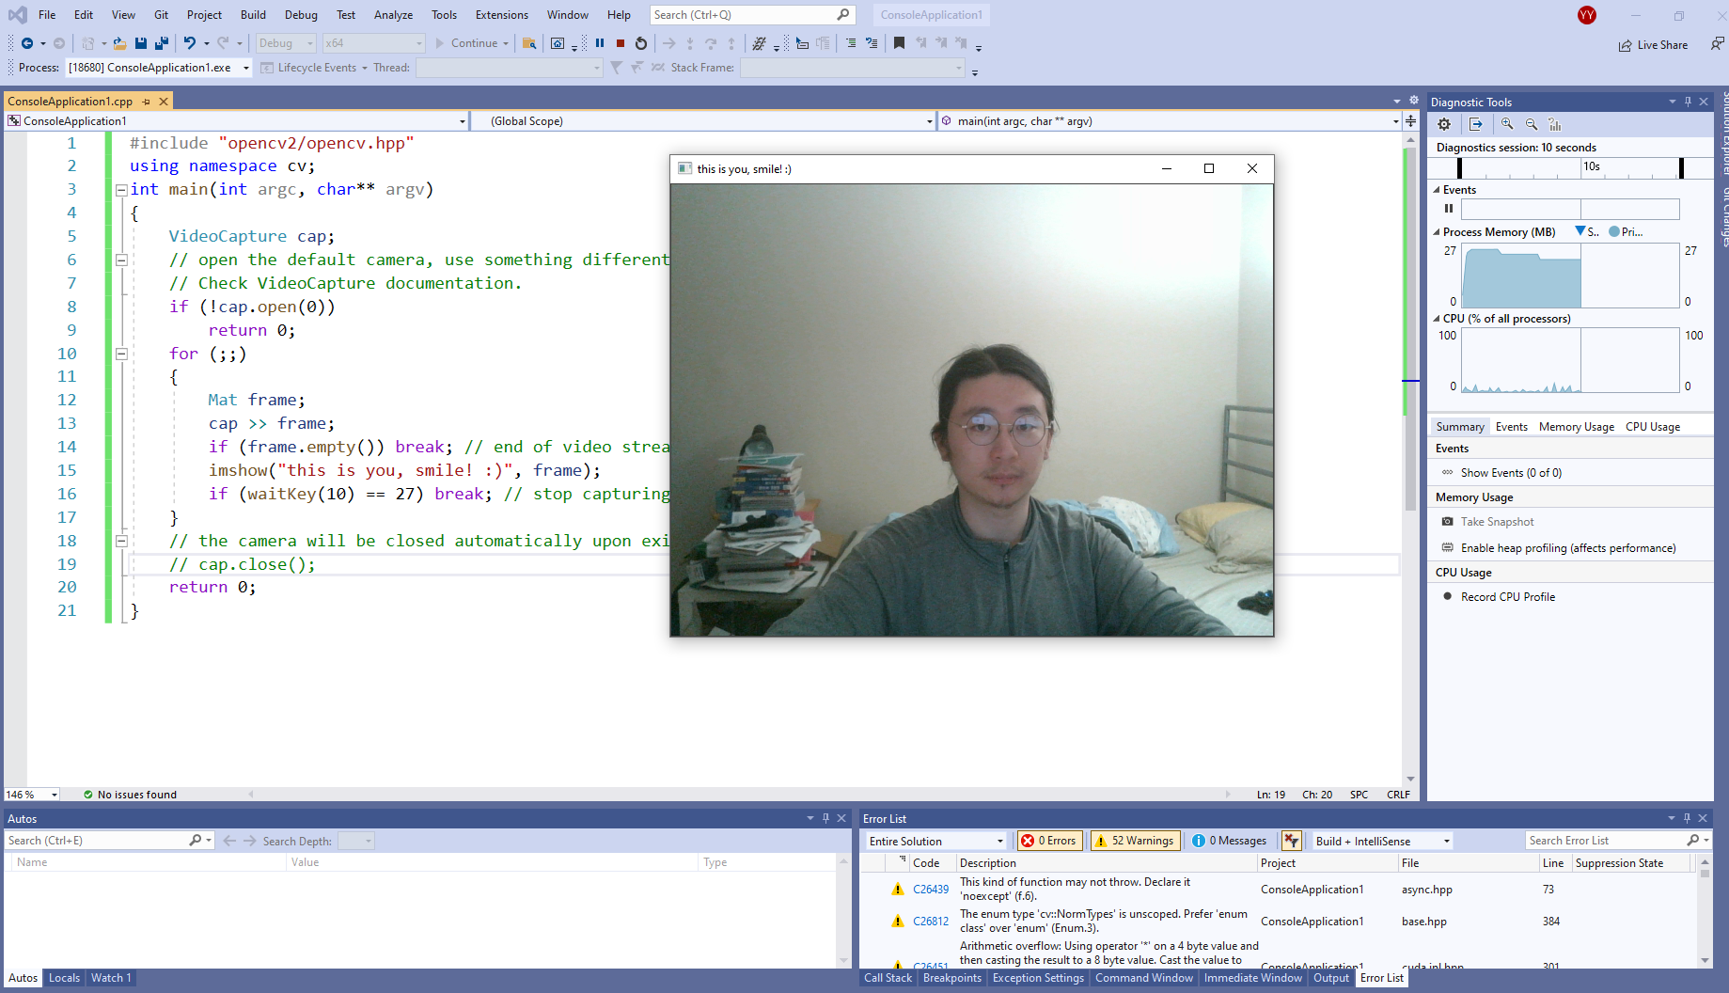
Yang Ye
Hardware: The video captured by the camera on the rover can be transmitted remotely to a receiver. The data stream will be then processed by the PC terminal. using OpenCV libraries)
Firmware: Setting up AV video signal converter
Software: Compiling OpenCV library.

Slide 9
Bill of Materials and Project Budget:
Rover Truck + Solar Panels +
SPDT switches + 10x*0.1F capacitors +
Box of capacitors +
shipping for Switches and cap = $87.42 + $13.00 + $8.28 + $18.39 + $13.39 ~ $140.48
Project Schedule and Risk Assessment: MILESTONES - Google Docs
Report and Presentation: 12th Feb 2021
Marketing and Video: 11th Feb 2021
Tips:
1. Be sure to identify tasks and contributions of each team member.
2. Use pictures as much as possible for effective communication.

